Slide 1
Welcome to Psych 100A Lec 1
If you haven’t already registered on Canvas, use this link and register now:
canvas.instructure.com/enroll/EPAMCE
Try to use the email address that the registrar has on file for you.
Must be CAPS

Slide 2
Welcome to Psych 100A
Spring 2019
Prof. Jim Stigler
TAs: Mary Tucker, Gerald Higginbotham, Laura Fries

Slide 3
Today
Introduction to the course
Get you registered on Canvas (if not already)
Get you registered on Poll Everywhere
Talk a little about statistics –
What it is
What the goals of the course are
How we will work toward those goals
Course requirements and grading

Slide 4
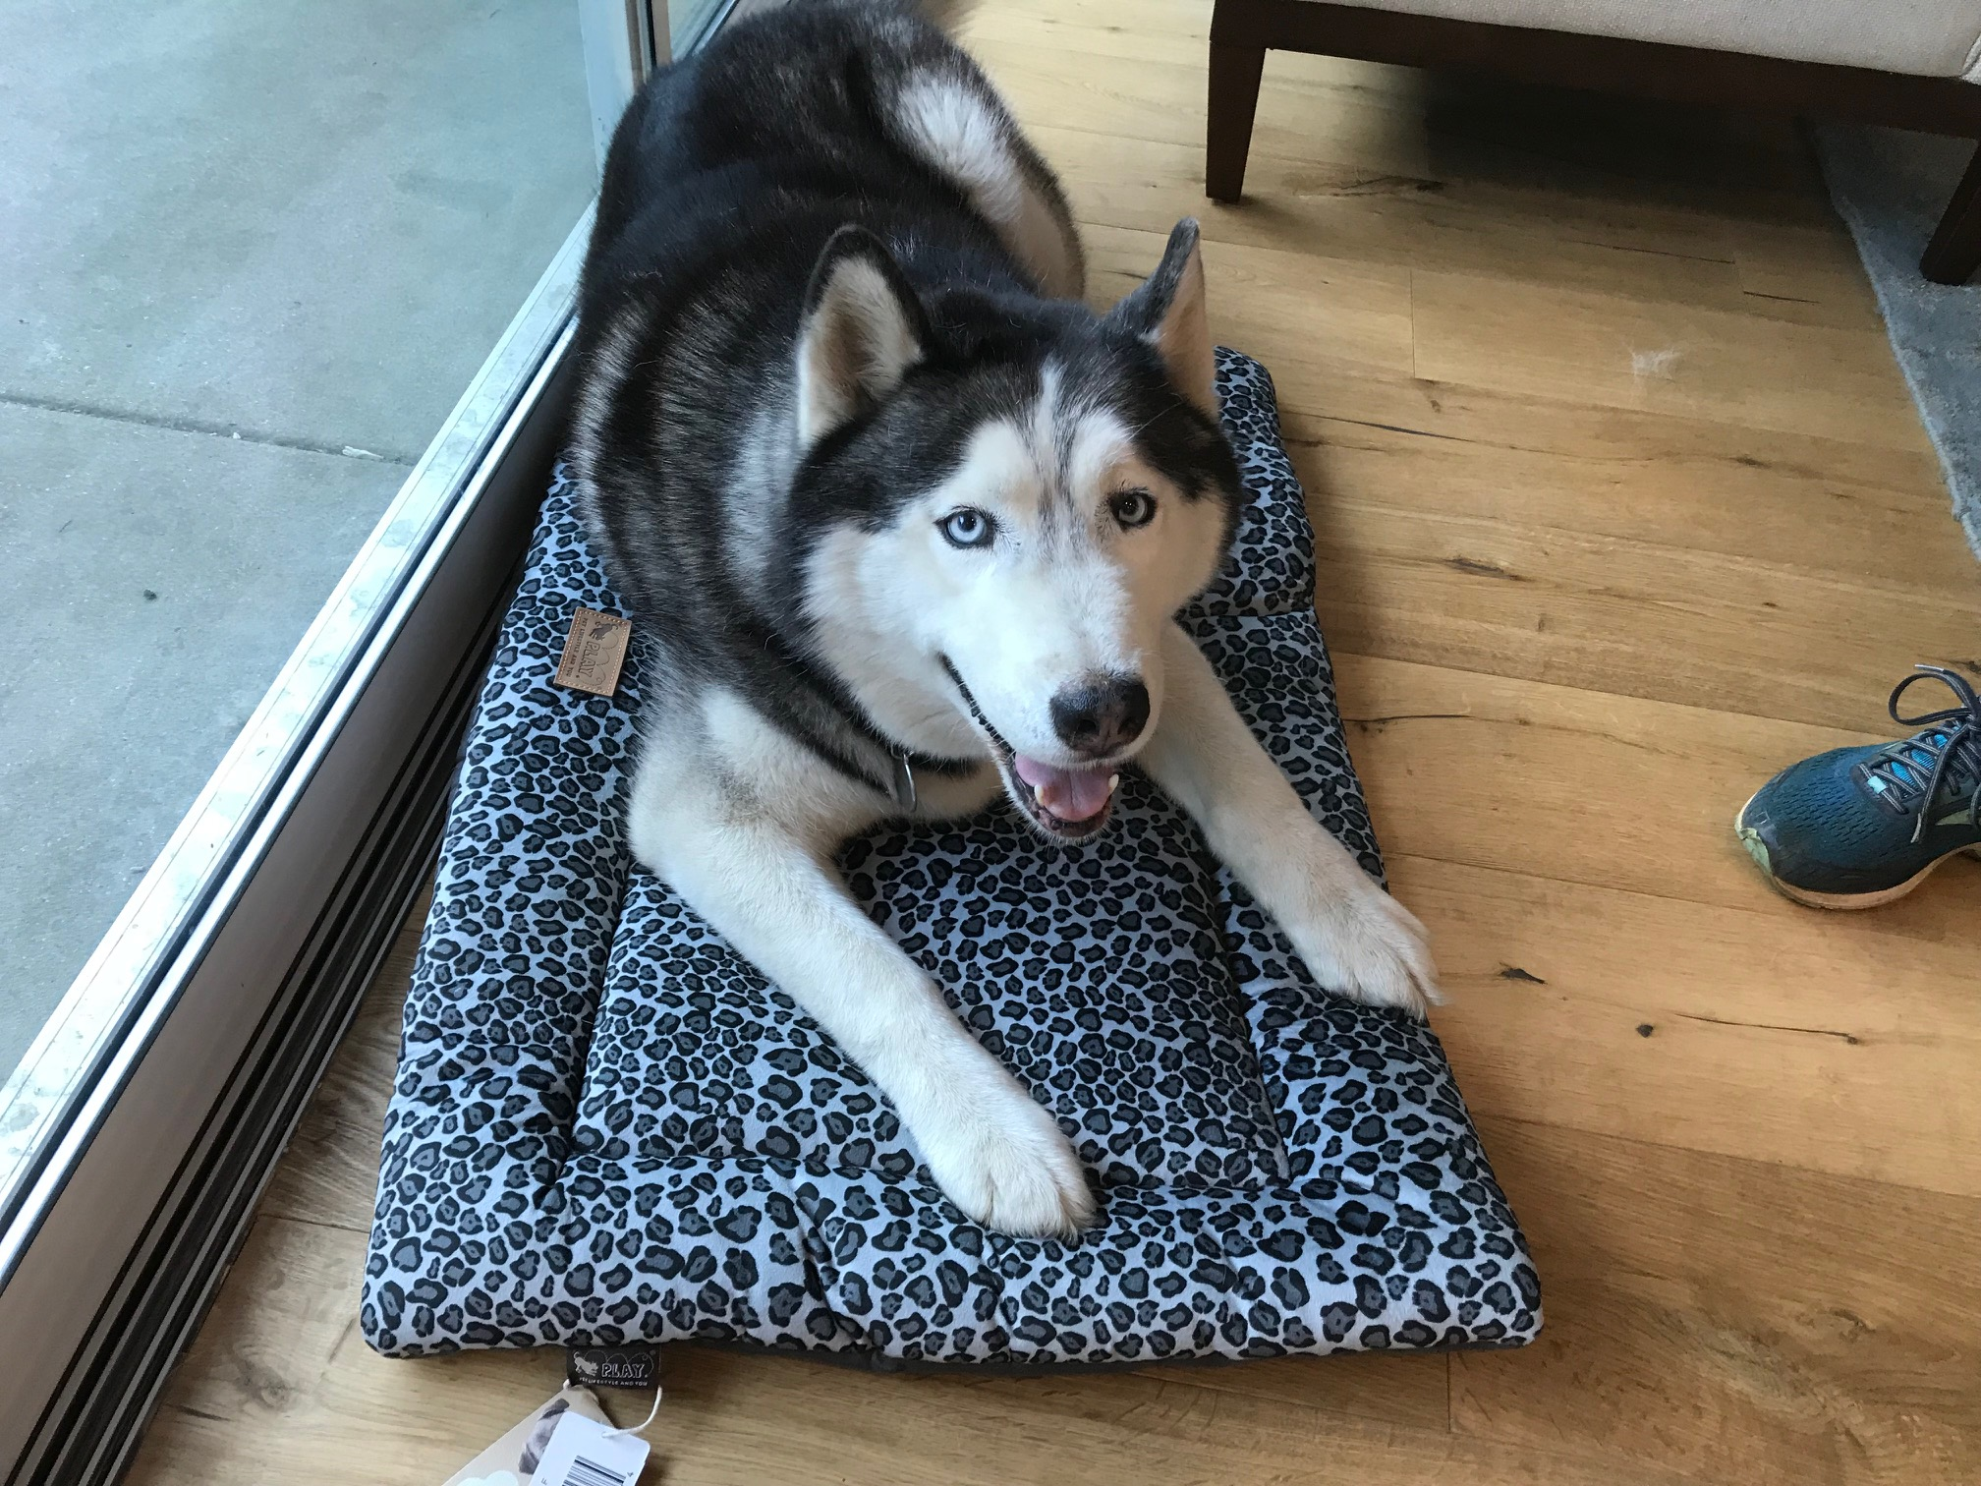
Moki

Slide 5
My math autobiography
Notes:
My math autobiography
Statistics and CLT
4th grade long division
Slow learner, but I always insisted on understanding why

Slide 6


Mathematics teaching in Japan and the United States
US: “Quick and snappy”
Japan: “Slow and sticky”
SOURCE: Hess & Azuma (1991)
Notes:
For many years, studied math teaching in different cultures, especially Japan and US.
Large differences in achievement, and in teaching.
Two scripts:
US: Show how, then practice steps
Japan: Struggle with hard problem, then discuss solutions
Helped me see what we do more clearly:
In US: Focus on memorizing facts/procedures - steps
In Japan: focus on understanding
Quick and snappy vs. slow and sticky
Consequences of this: we forget much of what we learn this way (evidence from college students)

Slide 7
This course
Notes:
Several years ago, started working with Prof. Ji Son (CSULA) to create a statistics course that would focus on understanding, not memorization.
Result is the online textbook.
Our job: try to create a course that will support understanding.
Your job: try to insist on understanding (like I did with long division) DON’T just apply your memorizing schema
Memorizing may help you get through a test, but it won’t help you incorporate statistical concepts into your thinking... which is my goal.

Slide 8
Sign Up for Canvas
If you have not already registered:
canvas.instructure.com/enroll/EPAMCE
Try to use the email address that the registrar has on file for you.

Slide 9
Sign Up for Poll Everywhere
First register for Canvas – do not register for Poll Everywhere until you have registered for Canvas!
If you have received an email from Poll Everywhere, follow the link to login.
If not:
go to www.polleverywhere.com/login
click “forgot my password”, enter your Canvas email address
check your email for link to set your password

Slide 10
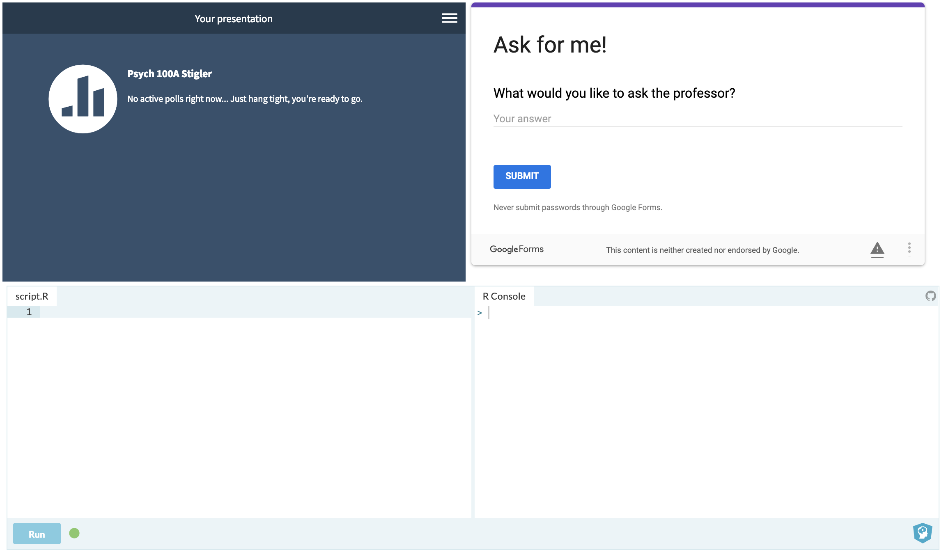
bit.ly/100Aclass
Try it out!

Slide 11
Poll Everywhere Questions
To answer a question
go to:
bit.ly/100Aclass
or
pollev.com/Stigler
and login.

Slide 12
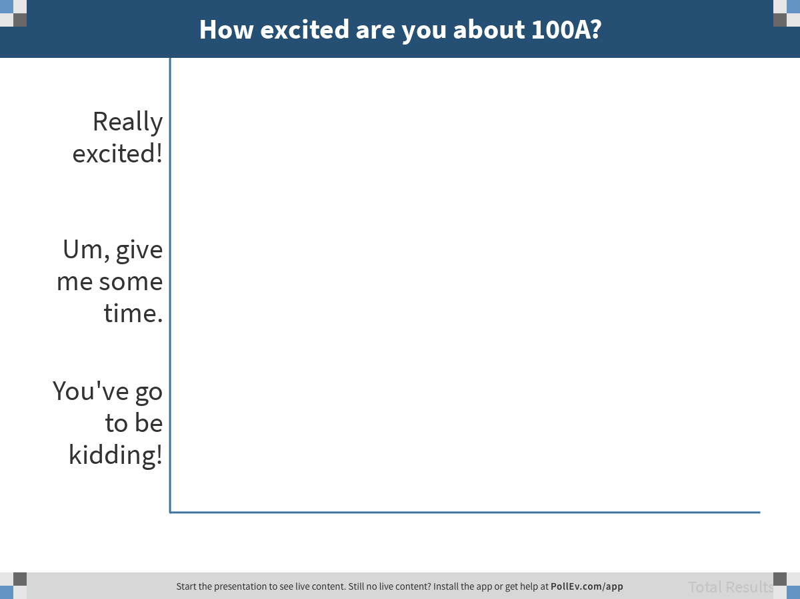
Notes:
How excited are you about 100A?
https://www.polleverywhere.com/multiple_choice_polls/FJnPAWq2RigopU2M3y4UO

Slide 13
What is statistics?
pollev.com/stigler

Slide 14
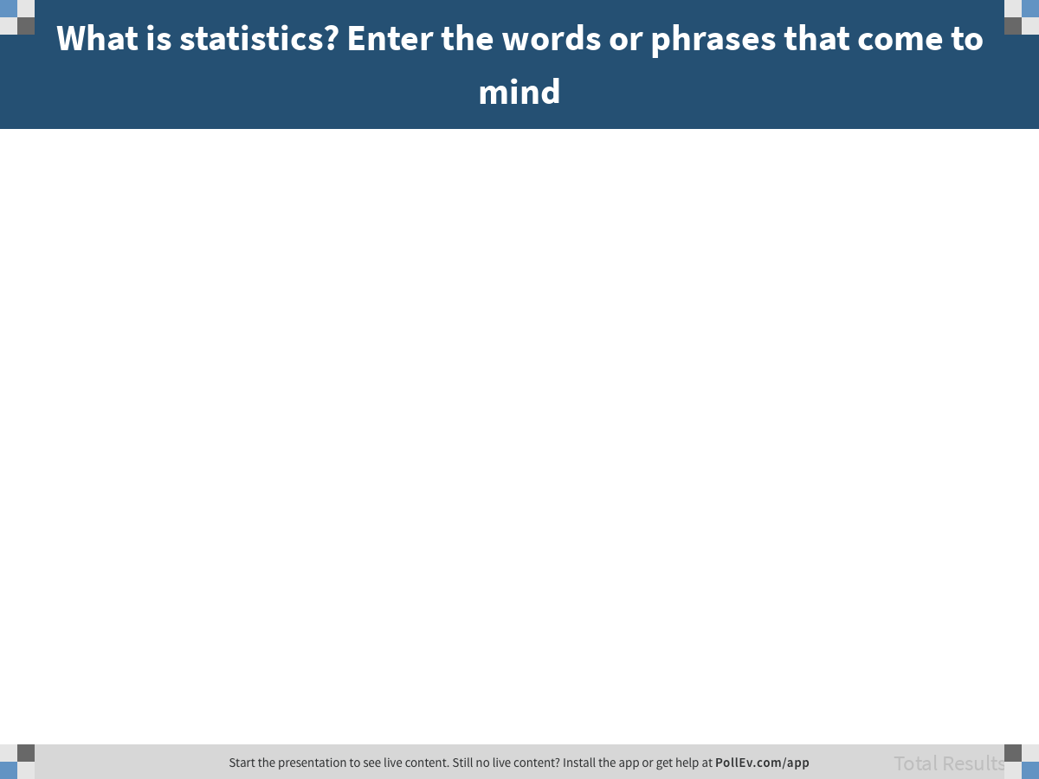
Notes:
What is statistics? Enter the words or phrases that come to mind
https://www.polleverywhere.com/free_text_polls/yLHGMljLZnuw1jhE0y9EP

Slide 15
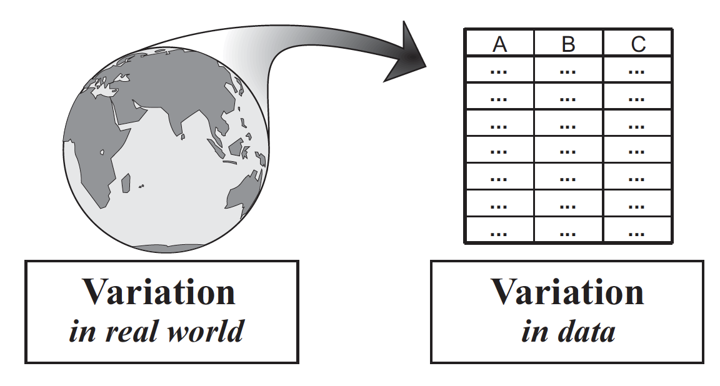
Statistics is the study of variation.
Notes:
Statistics is the study of variation.
We use variation in data to represent variation in world; try to find out about the DGP.

Slide 16
R.A. Fisher (1935)
“Men have always been capable of some mental processes of the kind we call ‘learning by experience.’ Doubtless this experience was often a very imperfect basis... Experimental observations are only experience carefully planned in advance, and designed to form a secure basis of new knowledge.”
⎯Design of Experiments
Notes:
R.A. Fisher quote
Variation makes learning hard because we aren’t sure of its source:
Explained
Unexplained, but resulting from unknown causes
Random
We deal with this in two ways:
Design
Analysis
What does it mean to study variation?
In some cases, obvious; look at the world - we can see lots of people, and these people vary.
But variation is harder to spot in other situations

Slide 17
Robert Martin was laid off from his job at Westvaco, Inc. soon after he turned 54 years old. He sued for age discrimination.
How do we evaluate his claim?
Martin v. Envelope Div. of Westvaco Corp.,
850 F. Supp. 83 (D. Mass. 1994)
Notes:
Let’s take an example.
Notice: no variation here because n=1.

Slide 18
Two Approaches
What comes naturally: see the threat, find the cause
Statistical approach:
Define a set of “cases” (e.g., all employees and their ages)
Look for pattern of variation
Consider alternative stories – mainly: random chance
We will explore this case further next week.

Slide 19
Muller-Lyer Illusion
Which line is longer?
Notes:
Turns out we are bad at seeing through variation; we are good at causal thinking.
Muller-Lyer illusion (something else we are bad at)

Slide 20
Muller-Lyer Illusion
Statistics is a tool to help us understand variation more clearly.
Notes:
Statistics can be like a ruler

Slide 21
Approach to the course

Slide 22
Things We Will Study
Statistic
Parameter
Sum of squares
Variance
Standard deviation
T-test
Correlation
Regression
Experiment
Random assignment
Random sample
Null hypothesis
Alternative hypothesis
Z-score
Z distribution
p < .05
Random variable
Quartiles
Interquartile range
Sampling distribution
Randomization test
Confidence interval
Sampling variation
Model
Chi-square
ANOVA
Normal distribution
Margin of error
F-test
Paired t-test
Notes:
How many of you have studied these things before? How many feel like you remember what they are? How many feel like you understand them?

Slide 23
Connections to Core Concepts
Statistical Model
Data
Sampling Distributions
DGP
Statistic
Parameter
Sum of squares
Variance
Standard deviation
T-test
Correlation
Regression
Experiment
Random assignment
Random sample
Null hypothesis
Alternative hypothesis
Z-score
Z distribution
p < .05
Random variable
Quartiles
Interquartile range
Sampling distribution
Randomization test
Confidence interval
Sampling variation
Model
Chi-square
ANOVA
Normal distribution
Margin of error
F-test
Paired t-test
Notes:
We will focus not on the differences but on the similarities and connections.

Slide 24
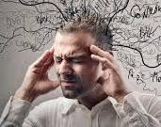
What is Understanding?
Few Connections
Many Connections
B
B
C
C
A
A
D
D
F
F
E
E
G
H
G
H
Notes:
Why core concepts?
Because they help to connect ideas together.
And connections is the underpinning of understanding.
Connections make knowledge flexible and adaptable:
Later more likely to remember
And more likely to be able to use to help the world!

Slide 25
What It Takes to Understand
For deep learning, with understanding, students need recurring and sustained opportunities for:
Productive struggle – with important mathematics
Explicit connections – among concepts, procedures, problems, situations
Deliberate practice – increasing variation and complexity over time
Notes:
Research shows three kinds of experiences are required to produce understanding:
Learning is hard; confusion is part of learning; desirable difficulties
If you are struggling, what does it mean? Tell yourself a different story…
Connections: to understand, you need to struggle with the right things – connecting procedures and examples with concepts.
And…

Slide 26
Understanding – like skill - takes deliberate practice. Complex concepts develop over weeks, months, and years.
Notes:
Understanding takes time!
Many of us have a Eureka! view of understanding; I used to use it to get my dad to stop helping me with my homework.
In reality: understanding takes time and practice.
Our approach: The Practicing Connections Hypothesis

Slide 27
Practicing Connections
What connections to practice?
Core concepts (those that tie the whole domain together)
Distribution triad
Statistical model
Representations (that you can become skilled at using
R
GLM notation
Data visualization
The world
The practice of data analysis
Contexts in which statistics can be applied
Notes:
So, our goal is to give you opportunities to practice applying core concepts (i.e., model and distribution triad) in the context of data analysis.
Why this context? Because this is what you want to learn how to do.

Slide 28
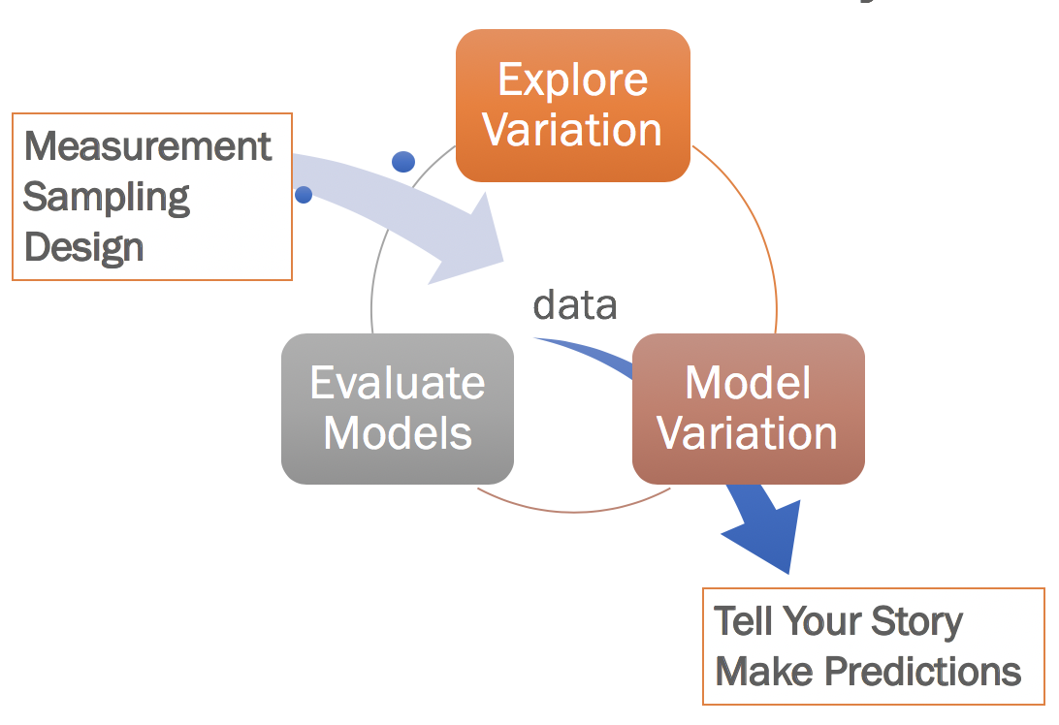
Doing and Thinking: Practicing Connections
Statistical Model
Data
Sampling Distributions
DGP
Do stuff with R
Apply core concepts to think about what you did with R

Slide 29
R
This is not a course in R
You will learn only a small set of R commands
Main purpose of R is to produce data analyses
But getting started learning R is valuable:
A way to start learning to code, which is fast becoming a basic skill
One of the main tools used in the fast-growing field of data science.
Notes:
Gina video

Slide 30
Course Goals
Understand basic concepts that underlie descriptive and inferential statistics, and be able to use these concepts to make sense of new situations.
Be prepared - both cognitively and emotionally - to learn more advanced techniques in the future.
Be able to do basic data analyses using R.

Slide 31
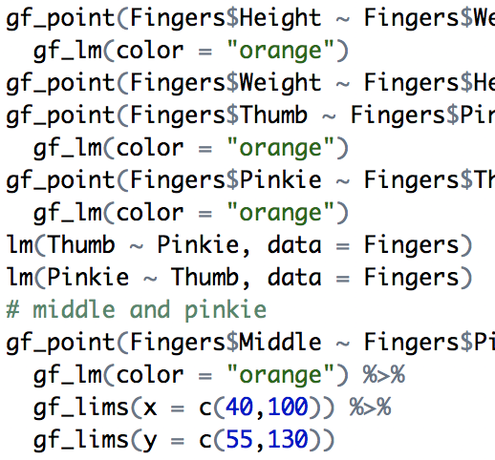
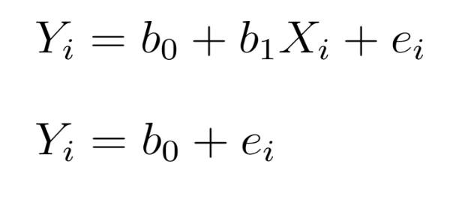
Things That Will Make Sense to You by the End of the Course
R Code
GLM Notation

Slide 32
How the Course Will Work

Slide 33
How the Course Will Work
Opportunities to Learn
Online text and homework (due Sundays at 11:30 pm)
Plan 6-8 hours per week
Lectures, focused on going deeper
Friday Labs (when not used for quizzes)
TA study groups and office hours
Assessment
Five quizzes
Final exam
Grading
See syllabus; note two weighting options
All Cumulative

Slide 34
Homework
Do every R exercise; go back and do them again for practice, but only after you think you’ve forgotten how
Answer every question, thoughtfully.
You must complete every page to get credit, but you don’t have be correct.
Proceed slowly and thoughtfully; challenge yourself to understand.

Slide 35
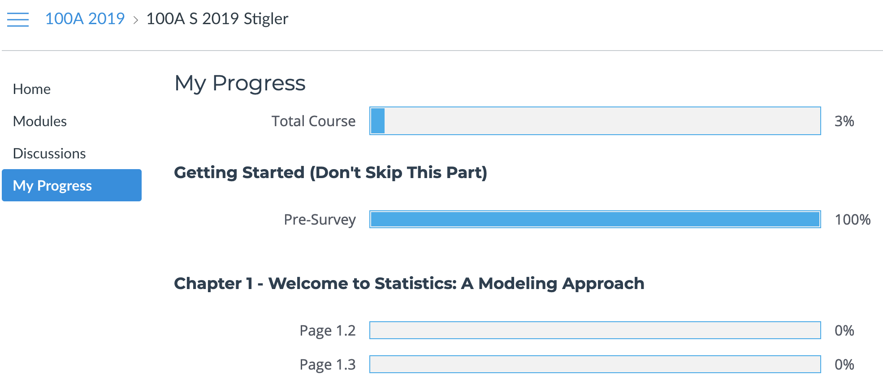
Keep Track of Your Progress
Due dates are on the syllabus! Read the syllabus!

Slide 36
Lectures
Focus on thinking and understanding in class
Slow pace
Examples
Questions
Discussion
No new content in lectures – it’s all in the online textbook.
Attendance not required…
If you do come to class, no use of devices for things unrelated to class.
Notes:
I realize it’s hard to focus on one thing for an hour and 15 mins.

Slide 37
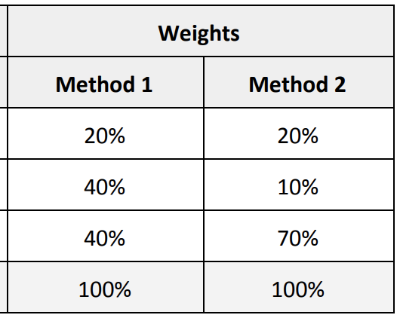
Grading
No curve; everyone can get an A in this class, and that’s our goal
Grade is based on:
Homework (completion only)
Quizzes
Final exam
Class attendance is recommended but not required

Slide 38
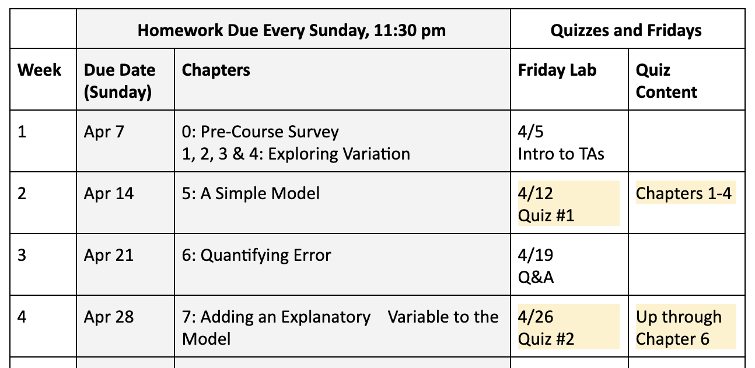
Schedule for First 4 Weeks

Slide 39
Get Help from Others!
Work with classmates; form your own groups
Go to office hours – instructor and TAs
TA Study Groups – fill out survey you will get by email
Try on your own first, then discuss with classmates and instructors.
Right now: introduce yourself to the person next to you; share your names and emails.

Slide 40
Read the syllabus!*
*Please
Notes:
Many of us have a Eureka! view of understanding; I used to use it to get my dad to stop helping me with my homework.
In reality: understanding takes time and practice.

